Slide 1
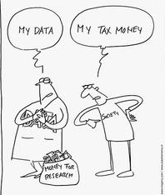
Management of URG Sharing experiences
Prof. H.K.I. Perera
Department of Biochemistry
Faculty of Medicine
University of Peradeniya
Workshop- 22.03.2022

Slide 2
Management
Project
Funds
Regulations
Milestones
As agreed
Monitoring- PR, FR
Completed on time

Slide 3
Management
Project
Funds
Milestones- Achievable
Ongoing
Preliminary data

Slide 4
Communications
All communications with SRC
SAR/Council and Academic- through Head, chairperson/FRC, Dean
PRs, FR
Any other communication- requests to transfer of funds, extensions
Advance requests, payment vouchers- To SAB- Through Head, Dean

Slide 5
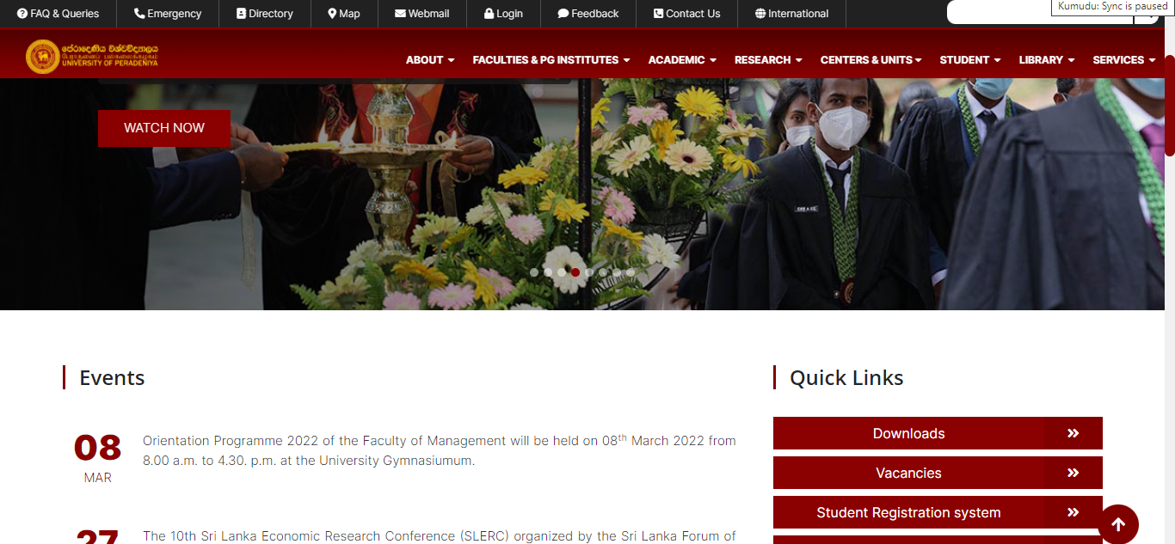
Regulations
PR, FR forms

Slide 6
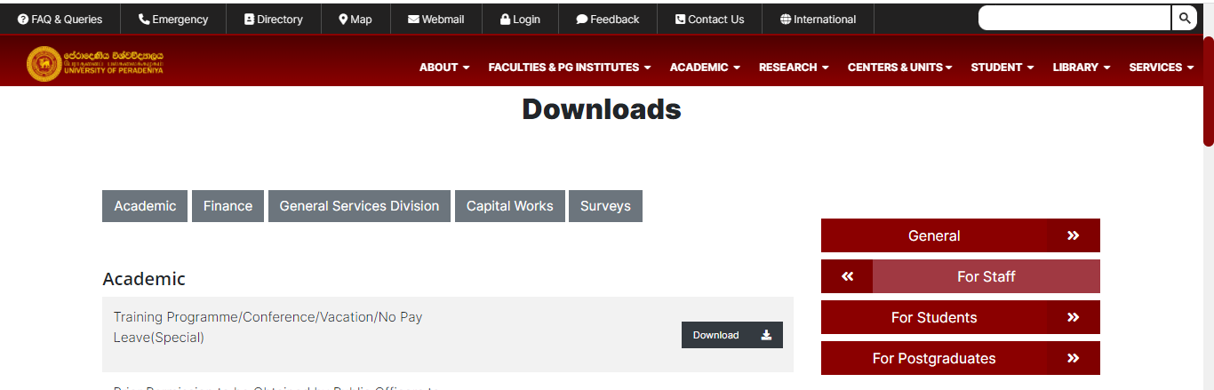
Regulations
PR
FR

Slide 7
Regulations

Slide 8
Funds are spent as agreed
Spend according to
the approved breakdown
only within the grant period
Know what is allowed
Know what is not allowed
Equipment, chemicals, consumables
Books
Field/ Lab assistance- casual or daily basis
Reimbursement of travel expenses
Salaries, Subsistence, OT
Expenses relating to foreign travel

Slide 9
After accepting
Request for approval- Purchasing of items (list of items)
Call for quotations from registered suppliers (include suppliers with good reputation/ past experience)
Selection of items for ordering

Slide 10
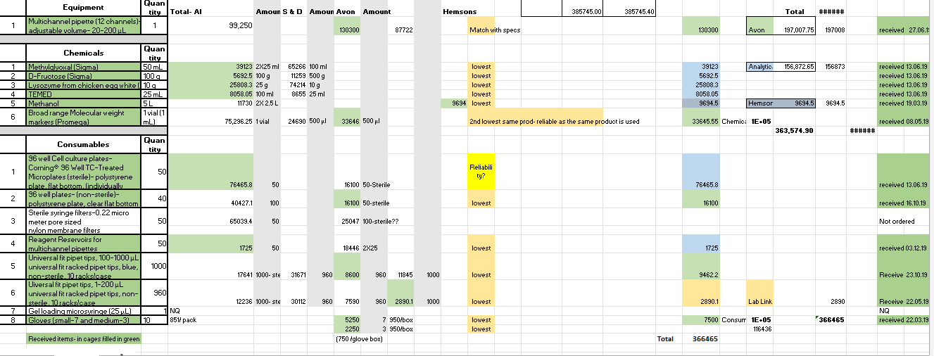
Tracking expenses
Detailed records of every transaction- multiple backups, a hard copy,
copies of invoices, receipts

Slide 11
Tracking expenses in different allocations
Careful financial planning and tracking- avoid overspending or underspending

Slide 12
Timely reporting
Periodic reports of progress- include the following information
Program implementation: Progress in comparison with the goals
Program outcomes: Assess how well expected outcomes are met
Financial overview: allocation, expenditure, and remaining funds
Challenges- problems, anticipated delays

Slide 13
Variations to the agreed terms
Changes may occur- delays which prevent you from completing objectives on time, reporting, or spending funds within the award period.
All variations to the agreed terms must be formally submitted and approved
Extensions to completion dates must be approved prior to that date

Slide 14
PR- half yearly
Submitted in duplicate
(a copy of the covering letter should be submitted directly to SAR/ Academic & Council for information)
PR1- (i.e., by 30th June)
PR2- (i.e., by 31st of December)

Slide 15
FR- 3 months after last PR
Submitted in triplicate
(a copy of the covering letter should be submitted directly to SAR/Academic & Council for information)
A comprehensive report- details of work carried out, the research findings
A summary of financial expenses- SAB to approve
Copies of all publications and presentations
A certified copy of the list of the items handed over to the Department

Slide 16
FR
All funds- fully and duly settled
All items belong to the Department- evidence to be submitted in FR

Slide 17
FR- 3 months after the last PR- If not steps can be taken to recover funds utilized
Mandatory to present findings at iPURSE- same year or following year
Acknowledge publications arising from the grant

Slide 18
Management
Project
Milestones archived
Funds
Spent as agreed
FR
Keep all the records safely

